Slide 1
Command Injection
Contributions by Dr. Duane Wilson, Wilson Innovative Solutions

Slide 2
Command Injection
In this lab, DVWA will be used to test out command injections and explore available files on the operating system.
Materials needed
Kali Linux Virtual Machine
Windows 7 Virtual Machine
Software Tools used
XAMPP

Slide 3
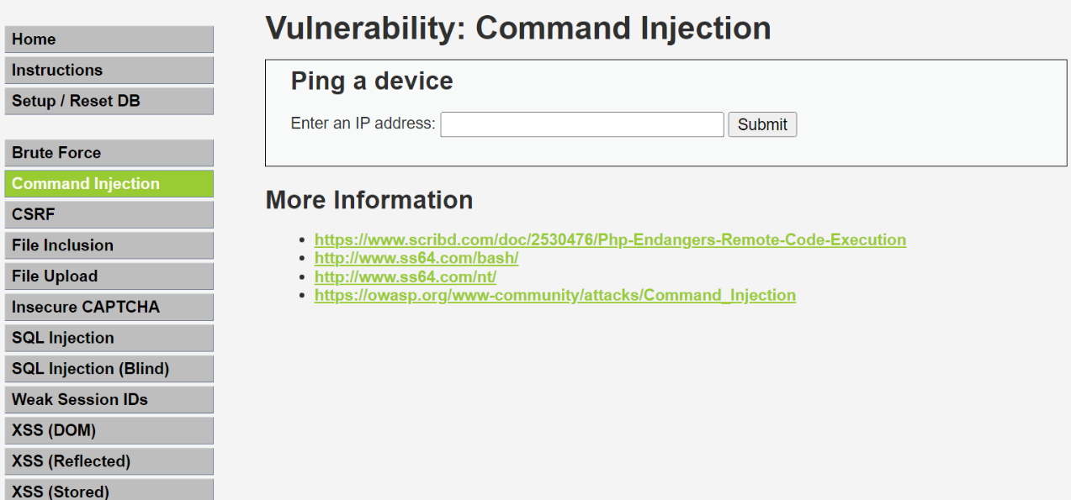
What is Command Injection
Command Injection is the process to testing either different strings of code or commands on the server a website is hosted on.
For this lab, we will be using the command injection app on the DVWA website.

Slide 4
The Command Injection Lab
Setup Environments
Access DVWA
Ping the Linux VM
Read files located on the Linux VM
Test limitations of DVWA’s command injection

Slide 5
Setup Environments
Log into your range
Open the Kali Linux and Windows 7 Environments
You should be on your Kali Linux Desktop
You should also be on your Windows 7 Desktop

Slide 6
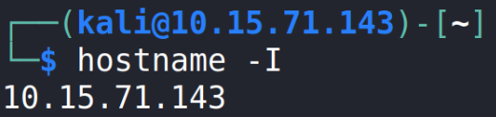
Find the IP Address (Kali Machine)
You will need the IP address of the Kali machine
Open the Terminal
In the Linux VM, open the Terminal and type the following command:
hostname -I
This will display the IP Address
Write down the Kali VM IP address
The IP Address

Slide 7

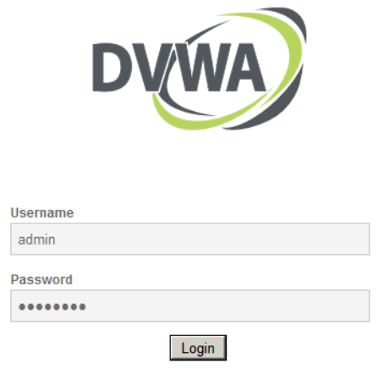
Log into DVWA
Start up the web servers (on the Kali machine)
If you used the DVWA Setup Lab, use the following command to start XAMPP (then start/restart all the servers):
sudo /opt/lamp/xampp start
On the Windows Machine, go to the DVWA webpage
http://<Kali-IP-Address>/dvwa
Login credentials are admin/password

Slide 8
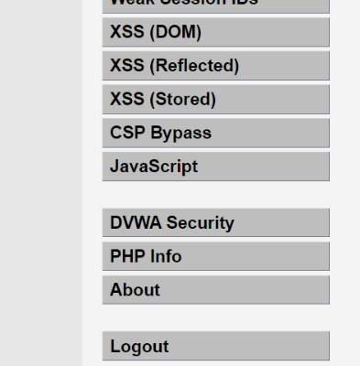
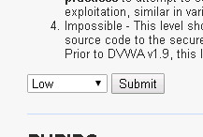
Log into DVWA
DVWA Security option
Login using the following credentials
Username: “admin”
Password: “password”
Click on the “DVWA Security” option
Change the Security Level to Low
Select Submit
This lowers the DVWA security to the lowest setting
Set to Low

Slide 9
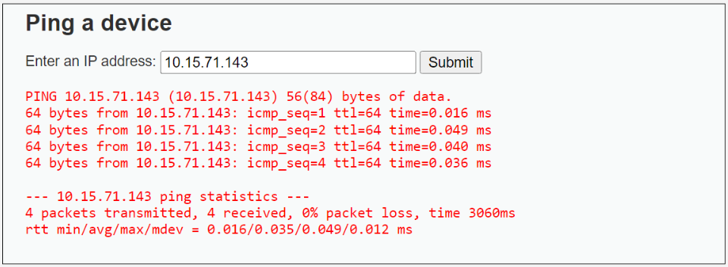
Ping the device
Click on the Command Injection tab
On the app’s input line, type in the IP Address of the host device
This will send a ping to the server hosting DVWA and return the following information.

Slide 10
Checking system information
While testing out different commands, it can help to know more information about the system you are working on.
Enter the commands:
#.#.#.# ; hostname
#.#.#.# ; whoami
These commands will display the OS of the device and user that you are logged in as
*using the | key can replace typing out the IP every command such as:
| pwd

Slide 11
Testing out commands
Through command injection you can test different Linux commands to view and manipulate information.
Type in the following command
#.#.#.# ; cat /etc/passwd
Reading the information shown under the input line, what is being displayed?
Are you able to display other files?
Are there any files you are unable to access?

Slide 12
Recreating file
In the input line type the following command to view the files in the tmp directory:
; ls –a /tmp
Keep note of which files are currently visible
You viewed the passwd file earlier, now it’s time to copy it
Type in the following command:
; cat /etc/passwd > /tmp/current
You can now reenter the first command:
; ls –a /tmp
You should notice a change in the files available in this directory
Typing the command ; cat /tmp/current should give you the same results from earlier showing that they are the same files.

Slide 13
Adding to a file
The file just created is in a folder that can be manipulated.
Type the following command and then view the file:
; date >> /tmp/current
; cat /tmp/current
You can also enter multiple commands on the same line using ‘&’
ie. ; command & command
After running these commands, you will should see the date appear at the bottom of the file.

Slide 14
Continuing with DVWA
You can continue to test out different commands on the DVWA site. There will be limitations due to the way the files are set up and the logged in user’s admin level.
Test out different combinations of commands such as:
Reading different types of files
Using cd to move through files and display how each command reacts when using multiple commands together.

